Slide 1
Predicting Bicycle Theft Risk Using Big Data
(Lambda Architecture + Real-Time Machine Learning) Afeena Gafoor MBAI 5100G
Big Data Systems Design 31 March, 2026

Slide 2
Key Insights
Nighttime = highest theft risk
Apartments/condos = most targeted locations
Downtown waterfront = major hotspot
Private spaces > public areas in theft risk

Slide 3
The Data
Night = 8613
Morning = 8411
Afternoon= 8157
Evening = 5649
Night Apartment (Rooming House, Condo) 2479
Night Single Home, House (Attach Garage, Cottage, Mobile) 1865
Night Streets, Roads, Highways (Bicycle Path, Private Road) 1265
Night Private Property Structure (Pool, Shed, Detached Garage) 995
Night Parking Lots (Apt., Commercial Or Non-Commercial) 673
Night Apartment (Rooming House, Condo) St Lawrence-East Bayfront-The Islands (166)Waterfront Communities-The Island (77) 147
Night Apartment (Rooming House, Condo) Wellington Place (164)Waterfront Communities-The Island (77) 140
Night Apartment (Rooming House, Condo) Harbourfront-CityPlace (165)Waterfront Communities-The Island (77) 135
Night Apartment (Rooming House, Condo) Annex (95)Annex (95) 130
Night Apartment (Rooming House, Condo) Fort York-Liberty Village (163)Niagara (82) 121
Night Apartment (Rooming House, Condo) Moss Park (73)Moss Park (73) 118

Slide 4
Mitigating Bicycle Thefts
City: police patrolling apartment complexes 6 PM and midnight.
Residents:
Safely secure their bikes
Use the “Bike Guard” app- predicts Risk Level

Slide 5
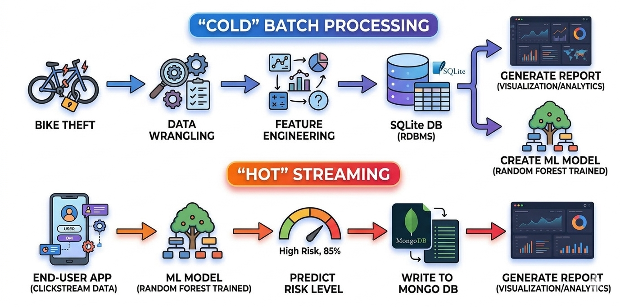
Big Data Pipeline

